Slide 1
Article 19
Update to the floodplain district

Slide 2
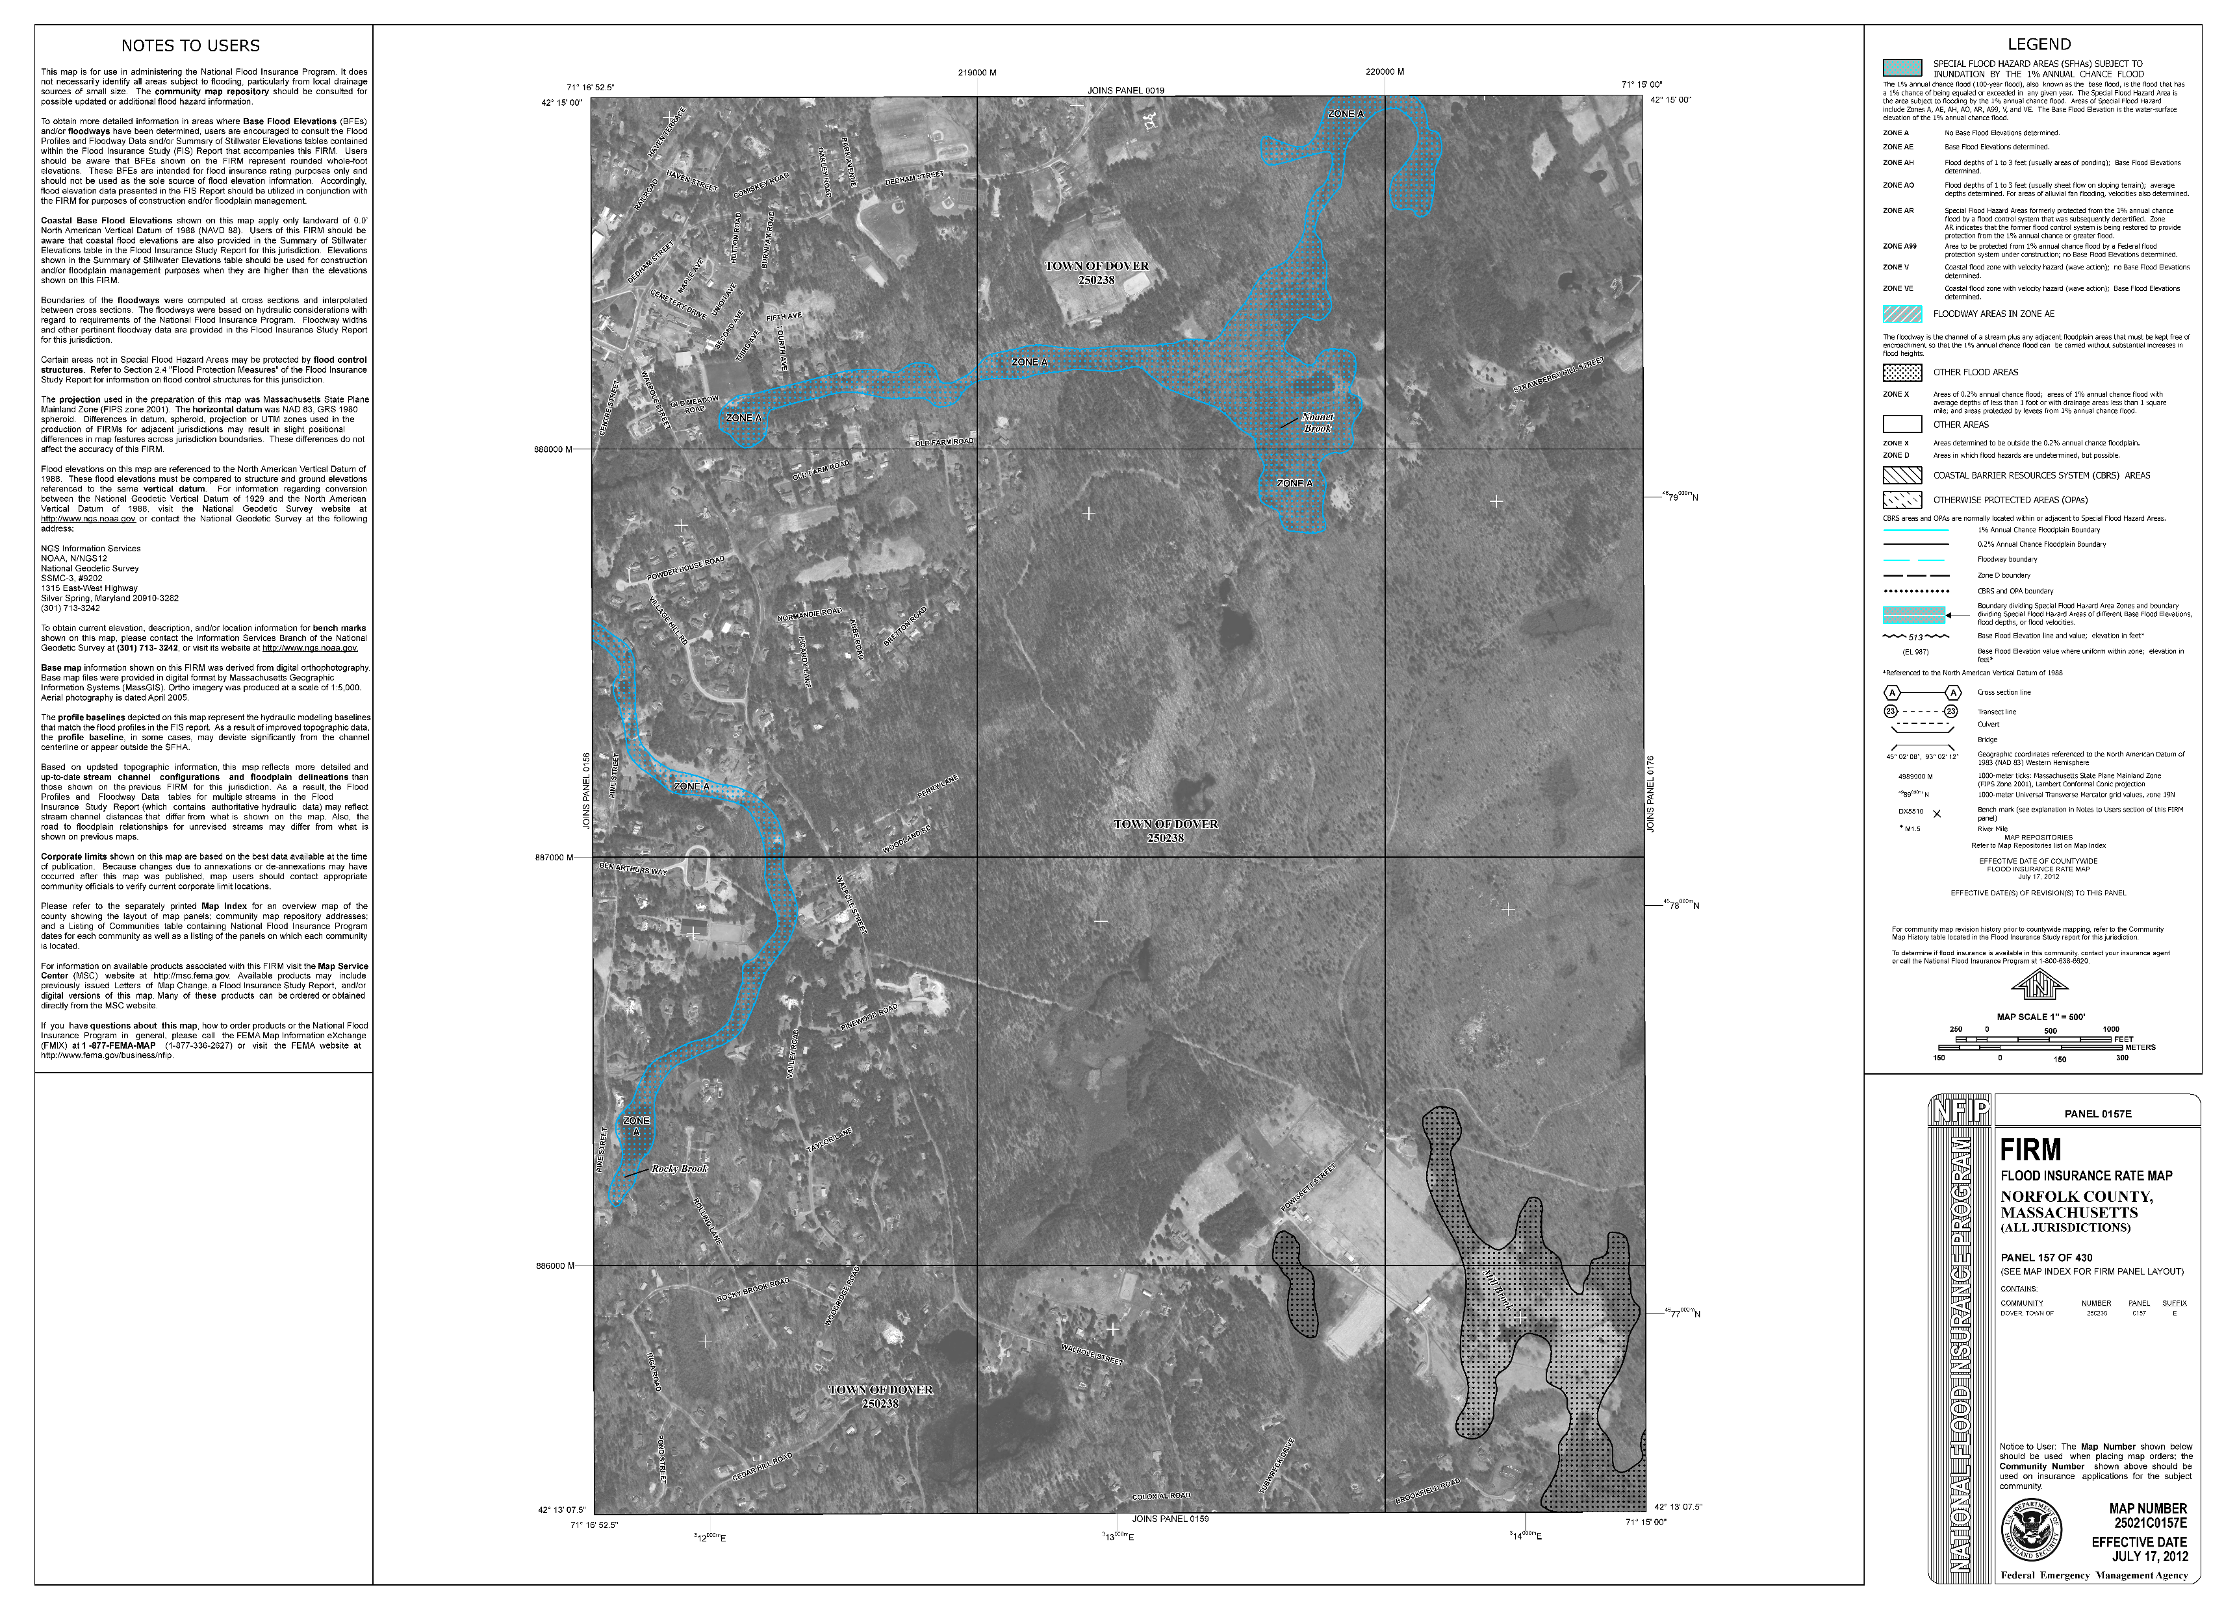
Overview of Updates
A flood insurance rate map (FIRM) is an official map of a community that displays the floodplains, special hazard areas, and risk premium zones, as delineated by the Federal Emergency Management Agency (FEMA). These maps must be adopted under the local zoning for communities to participate in the National Flood Insurance Program.
FIRM maps are updated every FIVE to TEN years. The last update was 2012.

Slide 3


Specific Bylaw Updates
To update the map references to the new (2022) Flood Insurance Rate Maps and Flood Insurance Study prepared by the Federal Emergency Management Agency; and
To update the text of Section 185-44 to remain in compliance with the requirements of FEMA’s flood insurance program. This includes new definitions and clarifications on work limitations within flood zones.

Slide 4
Voting Implications
Passes by 2/3 majority
Fails to pass by 2/3 majority
The Town and its residents are able to continue to participate in the National Flood Insurance Program
Dover is removed from the National Flood Insurance Program negatively impacting local homeowners requiring flood insurance
The proposed bylaw language was provided by DCR and should not be modified.
Failure to accept the new language as dictated by DCR and FEMA will nullify participation in the NFIP.

Slide 5
Thank you
Questions and comments

