Slide 1
Accessory apartments zoning bylaw update
Warrant article 18
Planning board

Slide 2
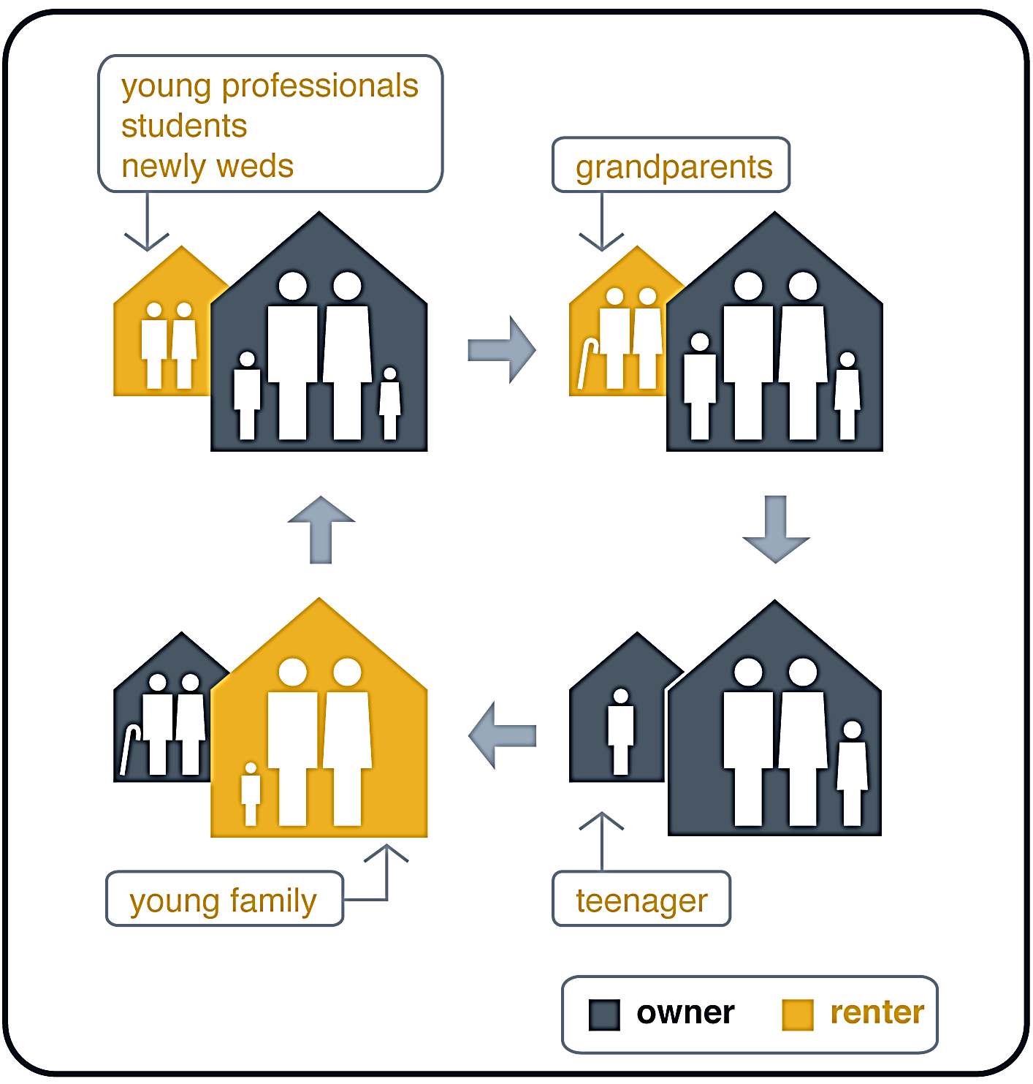
Why update the bylaw?
Who do accessory apartments serve?
Accessory apartments help facilitate “life-cycle” housing to help support the ability Dover residents of all ages to have their housing needs met.
TYPICAL DOVER SCENARIOS:
Aging residents on fixed incomes or residents with aging parents who would like to be closer
Residents with young adult children – particularly those with difficulty affording housing in the region
Residents with domestic employees (nannies, home care workers, farm works, etc.)
Estates with guest houses

Slide 3
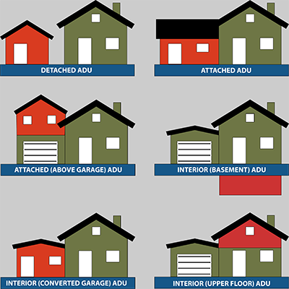
Accessory apartments are separate living units with sleeping, cooking, and sanitary facilities that are no larger than 900 s.f. (w/o a special permit) and are subsidiary to a single-family home. One unit must be owner-occupied.
Dover has allowed accessory apartments since 1986.

Slide 4
Proposed changes
Existing bylaw
Revised bylaw
Allows accessory apartments up to 900 square feet, attached, or detached, w/ PB, BOH, and ZBA approval.
Contains no statement of current policy pertaining to accessory apartments larger than 900 square feet
Mandates duplicative Three-Board Process
Contains language that is not legally defensible, making the Bylaw difficult to enforce in Land Court (Structures prior to 1986)
Continues to allow accessory apartments up to 900 sqft.
Creates option for larger units, subject to special permit and site plan review from the Planning Board
Streamlines the board review process
Capitalizes on existing Site Plan & Architectural Design Review Standards and Processes
Precludes Short-Term Rentals and requires owner-occupancy of primary or accessory unit
Makes no changes to BOH Requirements for private wells & septic systems – those still apply

Slide 5
Voting implications
Passes by simple majority:
Fails to pass by simple majority:
The Planning Board’s revised Accessory Apartments Bylaw will replace the existing Accessory Apartments Bylaw.
The Existing Accessory Apartments Bylaw remains part of the Zoning Bylaw.

