Slide 1
Article 20
Acceptance of Easements

Slide 2
Overview
Regulatory Context
Easements for acceptance
The Town has periodically been granted the right to use portions of private property (easements) for trail access
In order to be more enforceable, the easements should be accepted at TM
Easements were researched & catalogued by the Planning Board’s intern Steven Natola
Allowed uses range from general hiking, biking, to bridle path only. Some are open to general public while others are restricted to Dover residents or by permission only.
None require maintenance from the Town

Slide 3
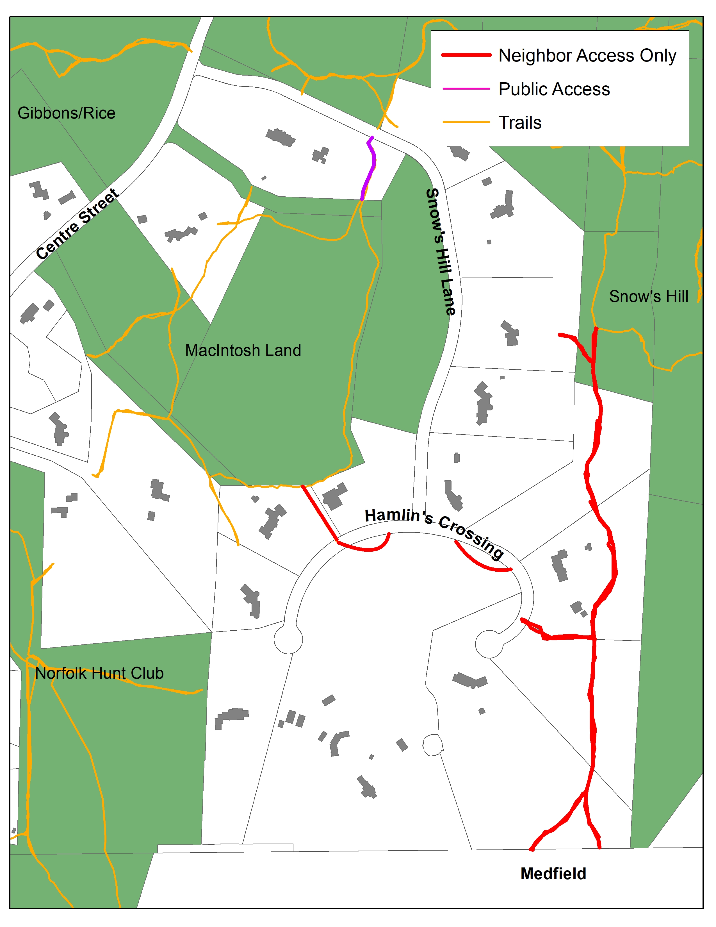
Snow’s Hill 1997-1998
Properties Subject to Public Access Easement:
1.) 1 Snows Hill Ln
Neighborhood Access Only*:
1.) 20 & 24 Snow’s Hill Ln
2.) 8 & 14 Hamlin’s Crossing
3.) 3 &5 Hamlin’s Crossing
*Includes Norfolk Hunt Club
Notes:
I think these are ‘neighborhood’, not Town – except #1 (separate easement to #2 & #3)
I think there are more trail easements here but they are part of the Snow Hill mutual/neighborhood easements – they are also Bridle/equestrian easements to the NHC
on the property line between 2L (#5) and 2M (#3)
Down the Walkey’s drive = property line 2G & 2H (#8) –
The Walkeys were happy to allow DLCT to create a trail from their Snow Hill piece (22-4) through the back of 22-2H to the network but DLCT declined because the network wasn’t public….
There is a lot more Public open space on this map than shown…..
16-048 is Wylde Woods (Con Com)
I believe sliver between 22 & 22C is Town – tax map has it 2E but no #
part of MacIntosh that you have marked – BTW, based on the deed, this should be Con Com-owned but it isn’t
22-2N isn’t part of MacIntosh & is Con Com (Koch deal as part of Snow Hill development)
16-047A & 16-047C are under CR (without access) to Con Com (Nightingale CR)
21-51 is Wardner Trust (NHC) & allows public access
17-23 & 17-24B& 17-24 17-25A is Con Com
17-25 is DLCT
Several parcels just off the right of this map are DLCT (22-4, 17-62)

Slide 4
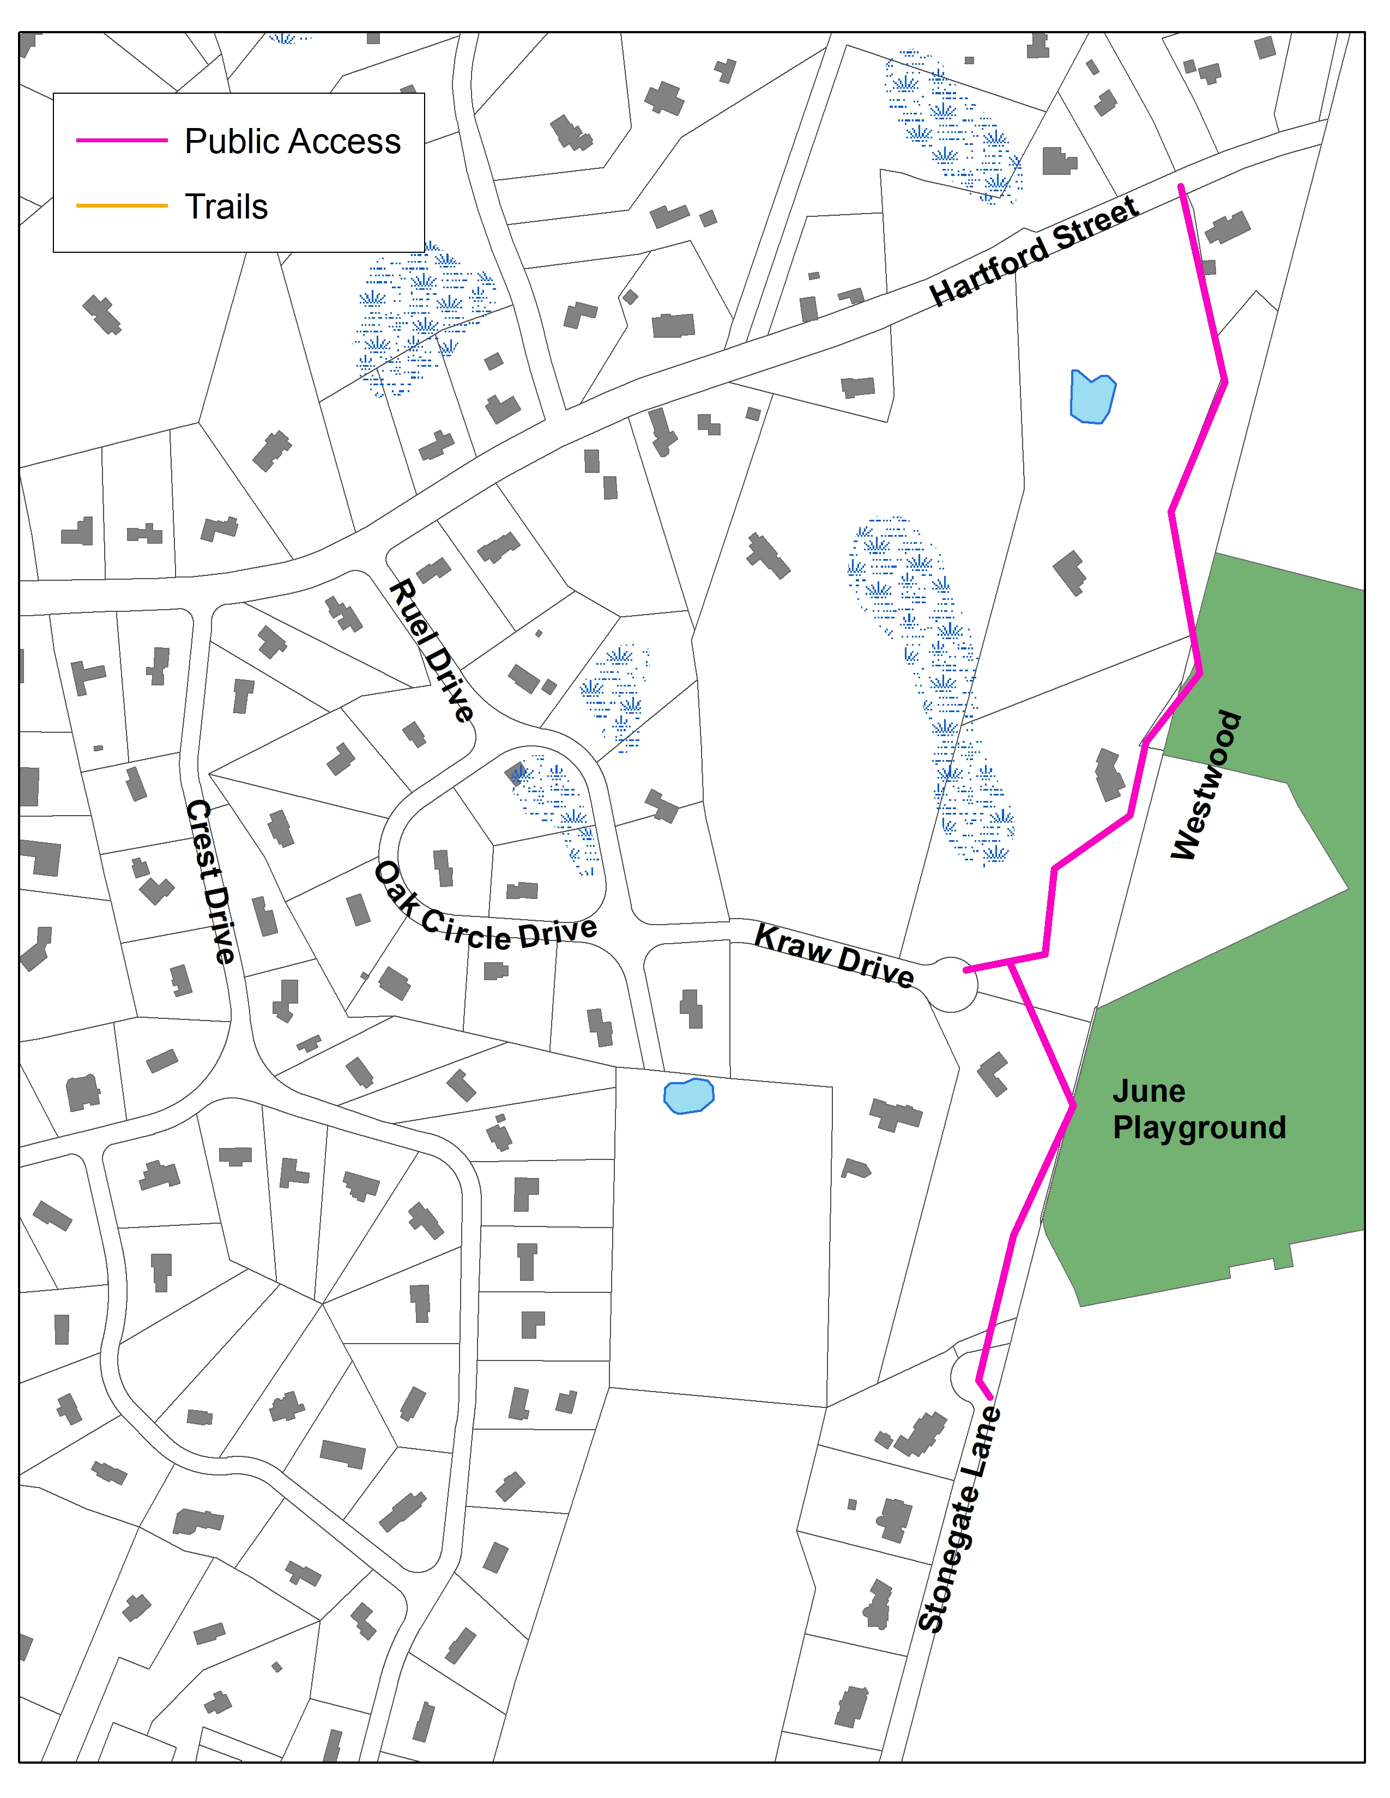
Bar-K Estates 1992
Properties Subject to Easements:
1.) 6 Hartford Street
2.) 16 Kraw Drive
4.) 17 Kraw Drive
Access easement for hiking, horseback riding, and cross-country skiing.
The easement provides access to 20+ acres of conservation land in Westwood
Access from Stonegate Lane to June Playground (Westwood)
Access from June Playground to Hartford Street
Notes:
Be helpful to have the tax map # referenced – this is #24
Be good to show the land in Westwood that belongs to Westwood Conservation Commission is 20.15 ac lot, June Playground (Westwood #27-22) and Hale 27-25 (3.54 ac)
Just off the top left corner (just past where Burgess comes into Hartford), there is a Westwood Con Com property Mill Brook Conservation Area (19-9 with 6.13 ac and Dover 24-149 on MA GIS, 24-73B on tax map with 1.3 ac) This property leads into the bottom of Hale – there are trails on Hale that go down near the border with this Westwood property but there look like too many brook & wetlands to make it accessible, sadly. We should ask Eric if this is the case.

Slide 5
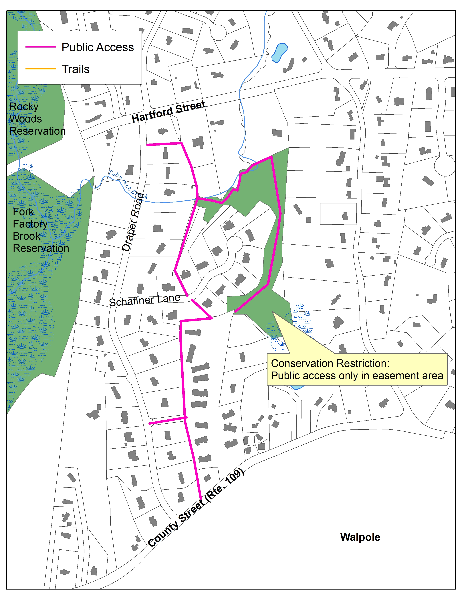
Brook Run & Warwick Acres - 1988
Properties Subject to Easements:
1.) Even #s on Draper Road
2.) All houses on Schaffner Lane
3.) Tisdale Drive Condos
Access easement covers trails only to allow hiking, horseback riding, and cross-country skiing
Notes:
Brook Run CRs held by the Con Com – Brook Run trails are part of the Access (section V) of the CR so I do not think they need TM Acceptance, right?
The CR altered slightly the bridle path agreed to with the Tisdale development so it goes to the top of Tisdale devt, jogs right along the top and comes into Shaftner between 25-12D & C
Then it goes straight across between 25-12 & 12G and then along as you have it (see green)
My Plans show the ROW going all the way around the property and along Tubwreck Brook to link back into the ROW (see purple)
Trustees Fork Factor Brook reservation is on the upper left side & Rocky Woods is left top above Hartford St – no trails to this side of either property ;-(
Water Company is 23-93J & associated easement
No easement between 3G & 3H

Slide 6
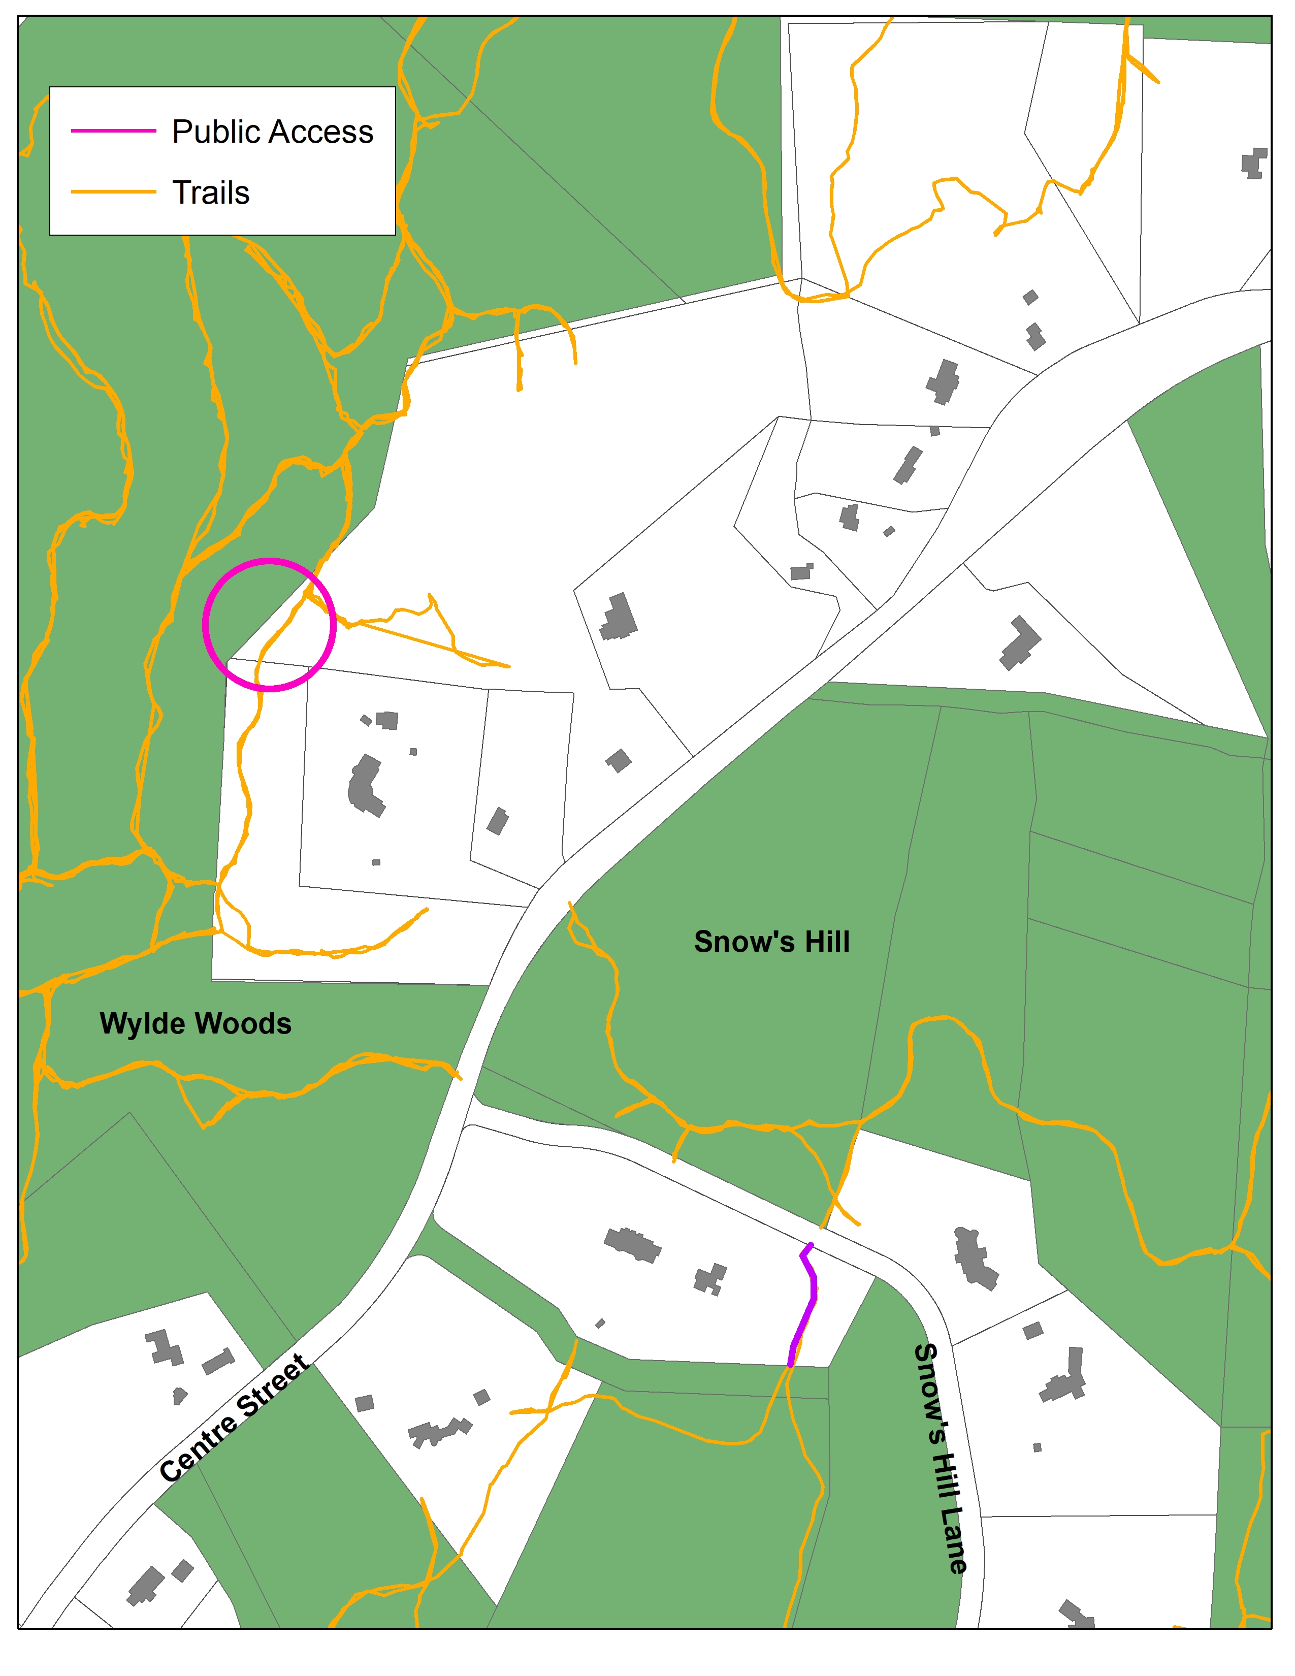
Centre Street 2000
Properties Subject to Easements:
1.) 695 Centre Street (17-17)
Trail Easement to preserve existing trail connection in Wylde Woods
Notes:
Show Wylde Woods (16-48 & 17-5)
Also, the property itself (17-17) appears to be under CR for 99 years to TPL and/or Con Com – do we want to note this.
The land along the far left on the other side of the MBTA is under CR (16-51 & 10-36 – Lesser/McKoy)

Slide 7
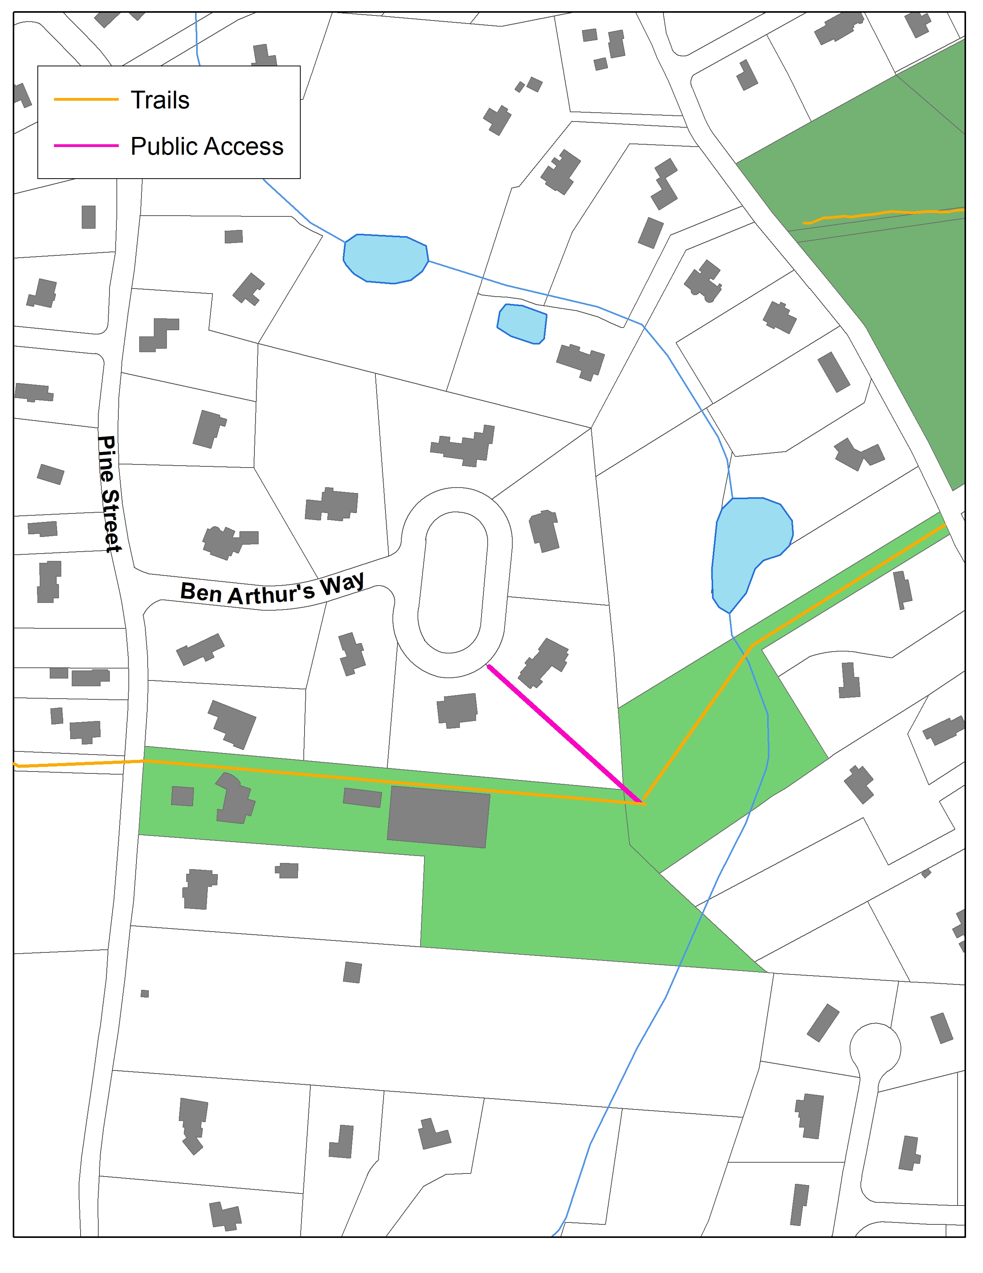
Dover Pines Estates 1994
Noanet
Woodlands
Dedham Street
Properties Subject to Easements:
1.) 15 Ben Arthur’s Way
Note: LT Farms (shown in light green is subject to a DLCT easement and is not town-owned conservation land)
Perpetual easement granted to Conservation Commission for hiking, horseback riding, and cross-country skiing (please walk bikes)
Notes:
This one belongs to the Conservation Commission, not to Town, so does it need TM acceptance?

Slide 8
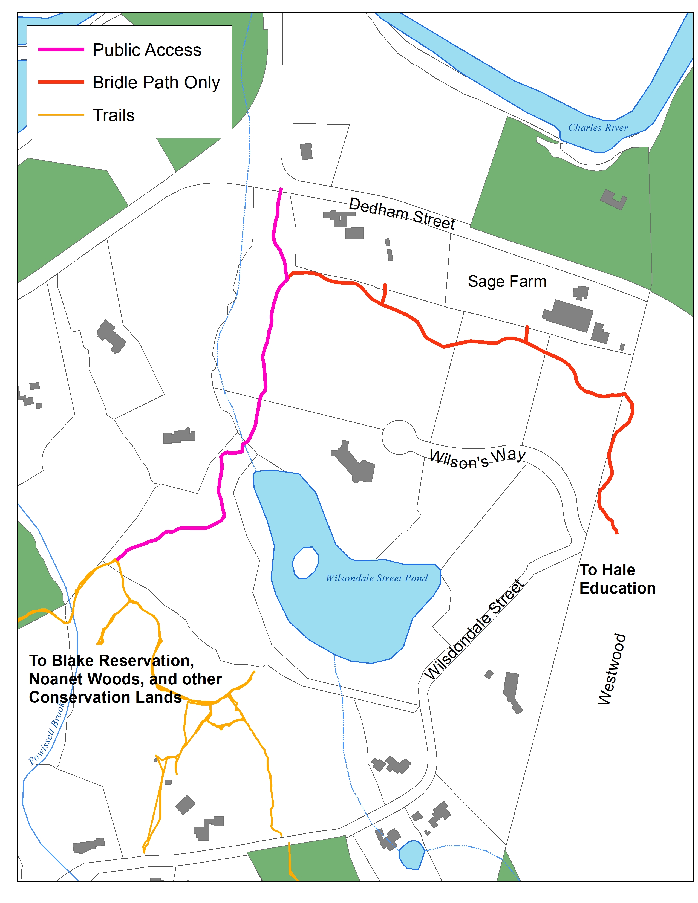
Wilson’s Way 2000/2017
Private (CR)
Properties Subject to Easements:
1, 3, 5, 8 Wilson’s Way
Conservation
Commission
Brodie
Equestrian Uses only in red,
general public access in fuchsia
Private (CR)
Hale
Notes:
The segment from Dedham St to the Con Com land (8-8C) is for Public or Dover residents (forget which). Bisson was supposed to actually create it. I think there is supposed to be a public trail from the end of Wilson’s Way to the public trail as well. The Con Com land has access to Wilsondale St (which is dry, beavers willing).
The section that runs along the top of the property is Equestrian Only.

