Slide 1
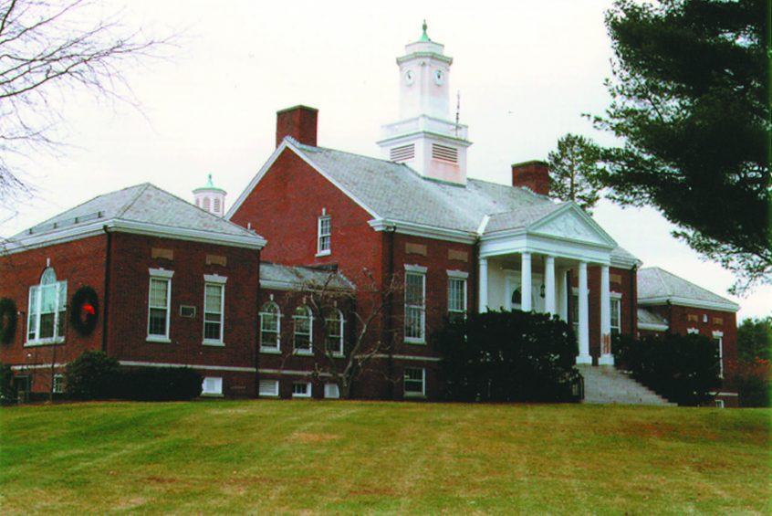
MBTA Communities Update
Dover, MA

Slide 2
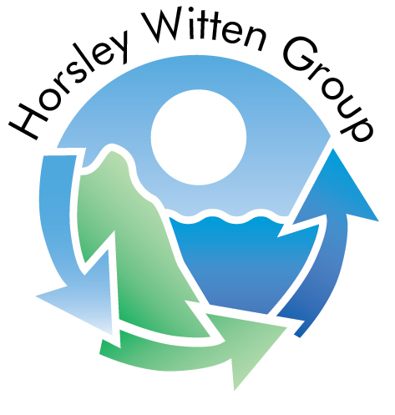
Prepared by . . .
Horsley Witten Group (HW) – Planning and Engineering firm based in Sandwich, MA
Jeff Davis, Senior Planner – Based in Providence, RI office
Providing free technical assistance to MBTA Communities through a grant managed by the Massachusetts Housing Partnership (MHP).

Slide 3
Background
Why is this state doing this?
Most multi-family housing in Massachusetts is subject to an unpredictable, time-consuming permitting process
Often requires a special permit, rezoning, or a 40B
Section 3A designed to remove barriers to multi-family residential near transit
Mass.gov/mbtacommunities

Slide 4
Sec. 3A of MGL c. 40A
MBTA Communities must have at least one zoning district in which multi-family housing is permitted by right (which can include Site Plan Review) and . . .
Minimum gross density of 15 units per acre
Located not more than 0.5 miles from a transit station, if applicable
No age restrictions and suitable for families with children, i.e. no bedroom or occupancy caps
Parity with other uses – multi-family housing cannot be required to meet higher standards than other permitted uses

Slide 5
Compliance Guidelines
Released by DHCD (now EOHLC) in August 2022
Provides step by step instructions for compliance
Includes a “Compliance Model” that calculates whether a municipality’s zoning and other policies comply with the law
For more information on the requirements related to Section 3A: www.mass.gov/info-details/multi-family-zoning-requirement-for-mbta-communities
Specific compliance guidelines:
www.mass.gov/doc/compliance-guidelines-for-multi-family-zoning-districts-under-section-3a-of-the-zoning-act/download

Slide 6
Affordable Housing
On top of the targets for housing density, the guidelines limit the amount of affordable housing that can be required
No more than 10% - No less than 80% AMI
Can be increased up to 20% in conjunction with a 40R district
Or by conducting an Economic Feasibility Analysis

Slide 7
MBTA Communities targets for Dover
MBTA Communities fall into four different categories:
Rapid Transit (those with T stations)
Commuter Rail (those with commuter rail stations)
Adjacent Community (those without a station, but adjacent to a municipality with one)
Adjacent Small Town (Adjacent Communities of 7,000 people or less or a population density of less than 500 persons per square mile)

Slide 8
MBTA Communities targets for Dover
Dover is a considered an Adjacent Small Town
Minimum multi-family housing unit capacity: 102 units (5% of Dover’s 2020 housing stock)
Minimum land area: None
Minimum gross density: 15 units per acre
Location requirements: None
Compliance Deadline: December 31, 2025

Slide 9
What do these targets mean?
Section 3A does NOT:
Require that multi-family housing be built (compliance is based on zoning that meets standards)
Compel communities to design or pay for new infrastructure to accommodate future multi-family development in a 3A district
Supersede MA Wetlands Protection Act nor Title V of MA Environmental Code
Zoning is a menu, not a development plan

Slide 10
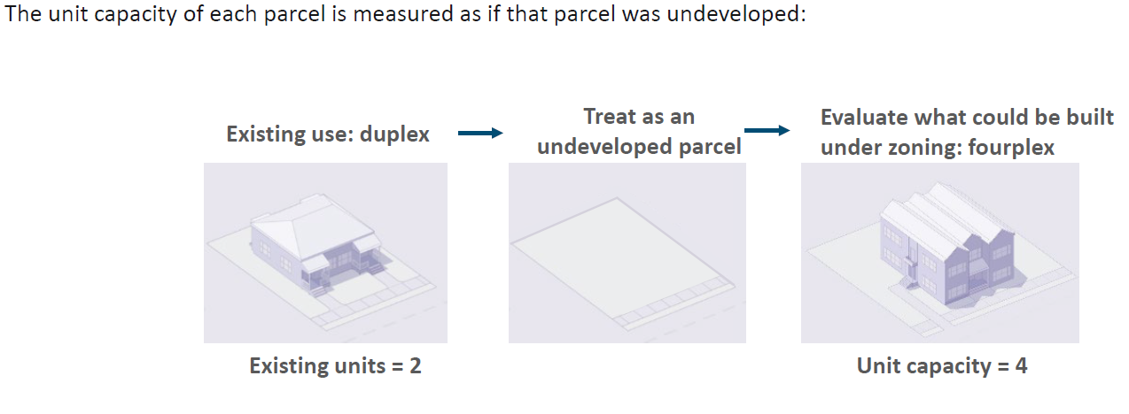
What do these targets mean?
Although some units may already exist, “unit capacity” for any given parcel may be higher or lower than existing development on the site.

Slide 11
Zoning for what?
Multi-family housing: “a building with 3 or more residential dwelling units or 2 or more buildings on the same lot with more than 1 residential dwelling unit in each building”
–MGL c. 40A §1A
Smaller-scale multi-family is encouraged in smaller towns!
Notes:
“Missing middle” housing types represent what Section 3A zoning requires.
These are the types of homes that might be a better fit for people at different stages of their life: Elderly, empty-nesters, young adults, single-parents, etc.

Slide 12
Testing the Compliance Model
HW will help the Town test the compliance model
Step 1: Determine district boundaries. Where might multi-family residential be appropriate? No minimum size required for Dover, but if the area is less than 5 acres it must all be contiguous.
Step 2: Determine dimensional requirements. How tall should buildings be in this district? What setbacks? What density?
Step 3: Ensure all zoning policy for the district complies with the law (affordable housing, policies that would limit family-sized units, etc.)
Step 3: Enter this data into the Compliance Model and “test” different iterations. Help the Town find a scenario that meets its needs as well as state law.

Slide 13
HW was asked to look at 4 40B developments
Two on County Street
County Court (Blue) and Red Robin Pastures (Red)

Slide 14
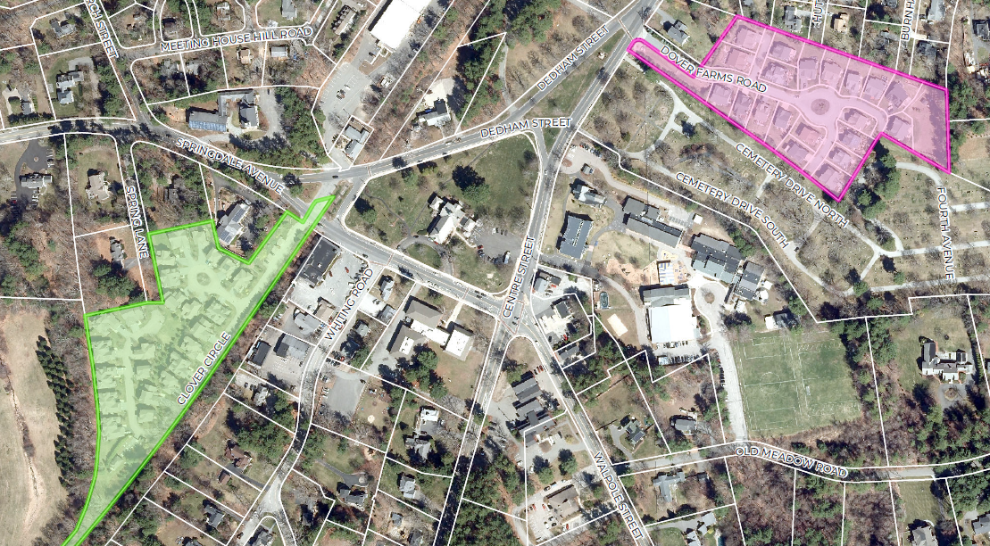
HW was asked to look at 4 40B developments
And two near Town Center
The Meadows (Green) and Dover Farms (Pink)

Slide 15
Proposed Dimensional Standards
Multi-Family By Right: Must be allowed by right per the law.
Minimum Lot Area: 20,000 SF (5,000 SF at Dover Farms).
Maximum Lot Coverage: 20% (50% at Dover Farms).
Maximum Building Height: 3 stories at County Court/Red Robin and 2 stories at Dover Farms/The Meadows.
Maximum residential density: 15 dwelling units/acre (minimum required by law)

Slide 16
Proposed Dimensional Standards
Minimum Front Yard Setback: 40 feet
Minimum Side Yard Setback: 25 feet
Minimum Rear Yard Setback: 25 feet
Parking: 2 spaces per dwelling unit.
Minimum Open Space: 50% (20% at Dover Farms)
Units per Lot/Building: No limit in this iteration – but could consider no more than 3-units per lot/building in Dover Farms/The Meadows

Slide 17
Testing the Compliance Model
All four areas calculated together
District Area: 24 acres (No minimum required)
Modeled Unit Capacity: 373 units (102 units required)
Dwelling Units per Acre: 15.6 (15 required)
Land within the station area: Not applicable
Unit capacity within the station area: Not applicable
All the targets are hit!

Slide 18
Testing the Compliance Model
County Court
District Area: 10 acres (No minimum required)
Modeled Unit Capacity: 149 units (102 units required)
Dwelling Units per Acre: 15.0 (15 required)
Red Robin
District Area: 3.8 acres (No minimum required)
Modeled Unit Capacity: 57 units (102 units required)
Dwelling Units per Acre: 15.5 (15 required)
County Court hits all targets on its own
(pending decision from EOHLC about how 40Bs will be treated, which will be done on a case-by-case basis)

Slide 19
Testing the Compliance Model
The Meadows
District Area: 5.3 acres (No minimum required)
Modeled Unit Capacity: 80 units (72 units if limit is 3 units per building)
Dwelling Units per Acre: 15.0 (13.6 if limit is 3 units per building)
Dover Farms
District Area: 4.9 acres (No minimum required)
Modeled Unit Capacity: 87 units (66 units if limit is 3 units per lot)
Dwelling Units per Acre: 17.8 (13.5 if limit is 3 units per lot)
If taken together with a limit of 3 units per lot/building, these two areas meet the unit capacity but not units per acre.

Slide 20
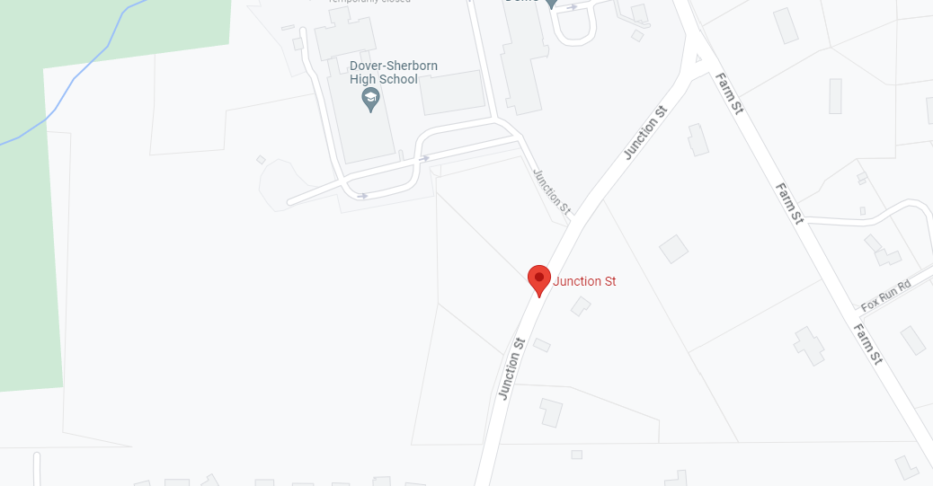
HW was then asked to look at Junction Street
Property owned by Pulte Homes

Slide 21
Proposed Dimensional Standards
Multi-Family By Right: Must be allowed by right per the law.
Minimum Lot Area: 20,000 SF
Maximum Lot Coverage: 30%
Maximum Building Height: 2 stories
Maximum residential density: No cap set – residential density based on lot coverage, building height, parking requirements, etc.

Slide 22
Proposed Dimensional Standards
Minimum Front Yard Setback: 40 feet
Minimum Side Yard Setback: 25 feet
Minimum Rear Yard Setback: 25 feet
Parking: 2 spaces per dwelling unit.
Minimum Open Space: 40%

Slide 23
Testing the Compliance Model
Results for Junction Street
District Area: 17.2 acres (No minimum required)
Modeled Unit Capacity: 214 units (102 units required)
Dwelling Units per Acre: 15.3 (15 required)
Land within the station area: Not applicable
Unit capacity within the station area: Not applicable
All the targets are hit!

Slide 24
Next Steps
There are a lot of ways to play with the model.
For example, the Town could allow 3 stories by right, increase the required open space to 50%, and decrease the maximum lot coverage to 20% and still hit your targets.
Dover has a low bar compared to other communities.

Slide 25
Next Steps
Prior to December 31, 2025: Amend zoning bylaws to be consistent with the MBTA Communities law.
There are many options, including:
Create an overlay zoning district or new baseline zoning district over one or more of the 40Bs explored in the first scenario. HW recommends floating this concept to EOHLC as soon as possible to see how they respond to a district made up strictly of one or more 40Bs.
Create an overlay zoning district or new baseline zoning district over the Pulte properties on Junction Street. Even very conservative dimensional standards should hit your targets.
Identify other properties appropriate for multi-family housing by right and run a new test in the compliance model.

Slide 26

Discussion
Any thoughts or comments?

